Slide 1

Movies Lifetime Gross Prediction

Slide 2
Overview
Gross refers to all earnings of a film from all revenue sources, including box office
The goal is to Create linear regression model that can predict the lifetime gross of a movie.

Slide 3
Project workflow
Web scraping & Data Gathering
EDA & feature engineering
Model building & training

Slide 4


Data collection
Scraped box
office mojo:
IMDb Dataset:
Title
Rank
Lifetime Gross
Overall Rank
Year
Title
Year
Genre
Duration
Country
language
Director
production company
Writer
Description
Actors
votes
Average vote
budget
Notes:
IMDb is an online database of information related to films, television programs, home videos, video games, and streaming content online – including cast, production crew and personal biographies, plot summaries, trivia, ratings, and fan and critical reviews

Slide 5
EDA
Delete duplicated rows and columns .
3
Merge the two datasets.
1
Delete null values.
2

Slide 6
Feature engineering
Delete unwanted columns.
1
Convert categorical values into dummy variables
2
Spit the date into year, month and day.
3
Convert from object datatype to numeric.
4

Slide 7

The model
Features:
Rank
Overall Rank
Year
duration
month
day
Average votes
Target value:
Lifetime gross

Slide 8

Model Testing
R- Squared in :
Baseline model
Training = 0.54,
Validation = 0.48
log experiment (experiment one)
Training = 0.93,
Validation = 0.91

Slide 9
Model Testing
R-Squared in :
Feature scaling (experiment two)
Training = 0.51,
Validation =0.53
Lasso model
Training =1,
Validation =0.99

Slide 10
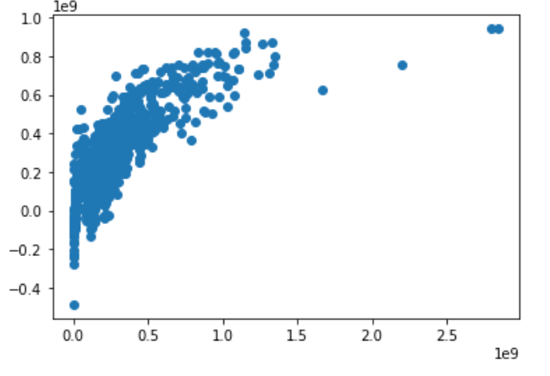
Graph Actual Vs Predicted
Observation:
Here the graph show the relationship between the features and our target values (Lifetime gross)

Slide 11
Thank You!

